Slide 1



Slide 2
OUR TEAM:
TEAM NAME:POCKET DYNAMITES
R . LOGA VARSHINI [LEAD] - Hardware & Designer
K . RAGESH – Design and development.
V . SIVA SUBRAMANIAN - Application developer
N . PRASANNA MURTHY - Hardware
P . PHENICIA SHARON - UI Designer

Slide 3
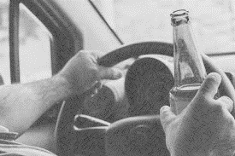
INTRODUCTION:
Road accidents claim many lives daily, primarily due to over speeding and drunk driving. While technology helps curb over speeding, drunk driving remains a persistent issue, causing heartbreaking losses for families and loved ones.
Drunk driving harms not just the offender, but innocent citizens, their properties, and loved ones. We urgently need solutions to prevent this menace."

Slide 4
PROBLEM STATEMENT:
Currently, manual solutions like breath analyzers and blood tests exist to detect drunk driving, but drunk drivers often find ways to escape detection. We urgently need a more reliable and automated replacement for these manual processes to curb drunk driving.
What automated solution can effectively address the issue of drunk driving?

Slide 5
PROPOSED SOLUTION:
As an automated solution we came up with an idea of using biochemical sensor testing to detect and differentiate between sober and drunken states, and store this data in a mobile application .
Our solution detects drunk driving without needing a third person's intervention and saves time and cost on testing .

Slide 6
PROPOSED METHODOLOGY:
DETECTION / TESTING :
Transdermal Alcohol Sensors use biochemical detection to measure BAC through sweat, providing real-time, non-invasive monitoring .
DATA ANALYSIS AND SHARING :
Collected data is analyzed and integrated using ESP8266 module, this is programed by Embedded c language .
APPLICATION DEVELOPMENT :
We've built a cross-platform driver-admin connectivity app using React Native, with a robust Django Rest Framework backend for seamless data management .

Slide 7
GAP ANALYZED WITH EXISTING SOLUTION:
BREATH ANALYZERS
SAFE GRIP
Breath analyzers: Not always accurate, and drivers may find ways to manipulate results.
Police checkpoints: Limited in number and often ineffective.
Driver background checks: Don't account for real-time intoxication.
Does not need any police check points to check.
Manipulation of results is impossible.
Real time monitoring.
Data from the sensor is stored in the app and updated in real-time.

Slide 8

BUSINESS OPPORTUNITIES:
Our product can be Integrated with existing vehicle management systems.
Collaborate with vehicle manufacturers (OEMs) for built-in solutions.
Partner up with insurance companies for discounted rates.
Team up with ride-hailing services ola , uber, Rapido to expanded customer reach .
Join forces with road safety advocacy groups.

Slide 9

SOURCE OF REVENUE:
Subscription Fees: Monthly/annual fees from rental car companies, fleet operators, and ride-hailing services.
Licensing Fees: One-time or recurring fees for integrating the app with existing systems.
Per-User Fees: Charging drivers or companies per usage.
Advertising: Targeted ads within the app.
Data Analytics: Selling anonymized data insights to research institutions, insurance companies, or government agencies.

Slide 10
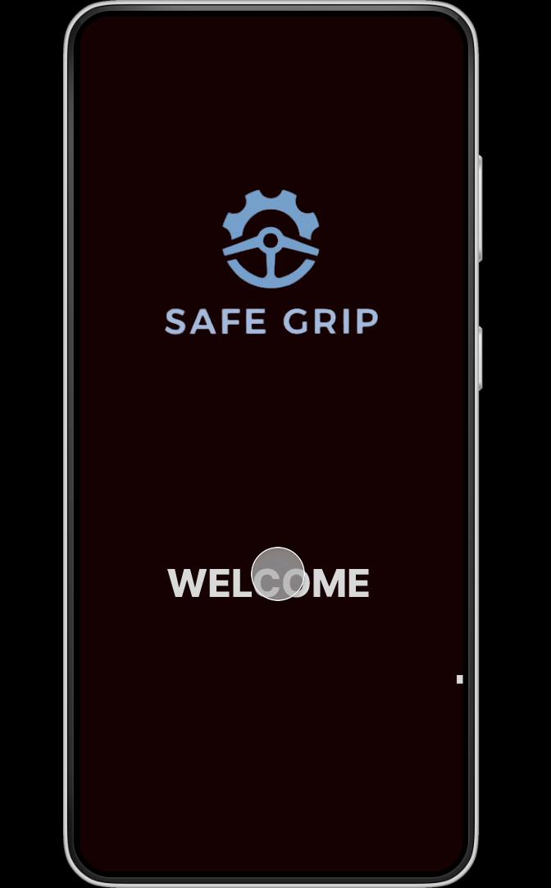
PROTOTYPE:
https://www.figma.com/proto/4c0muFZFX5ST4hby2iY9iE/Untitled?node-id=0-1&t=2wqollSz07fBEnWI-1

Slide 11
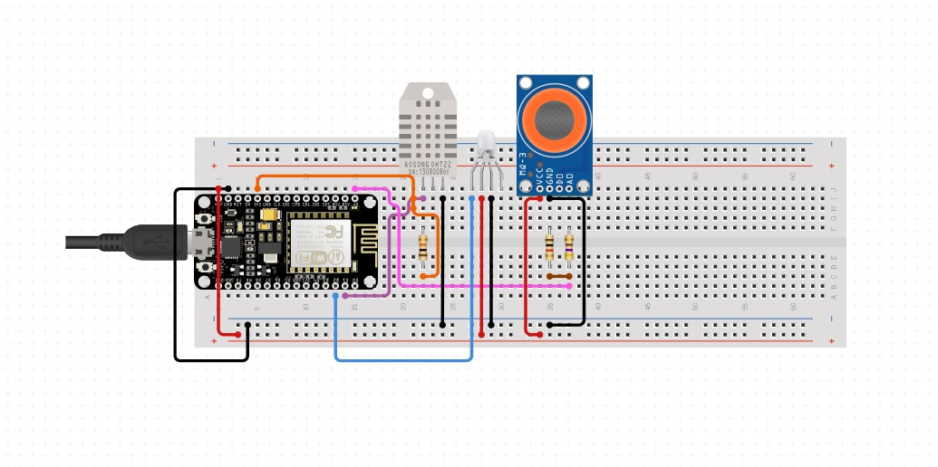
HARDWARE PROTOTYPE:

Slide 12
PROBLEM FACED AND OVERCOMES:
Initially, the transdermal sensor's output signal was too weak to be detected by the ESP8266 module. To overcome this challenge, our team designed and constructed an amplifier circuit utilizing operational amplifiers (op-amps). This successfully amplified the signal, enabling reliable detection and transmission of sensor data to the ESP8266.
In our alcohol detection project, sensor sensitivity issues arose due to interference from ethanol-based products. To overcome this, we're implementing a machine learning solution, training an algorithm with extensive datasets to ensure accurate and reliable result

Slide 13
PROBLEM FACED AND OVERCOMES:
Our sensor's restart time caused prolonged variations after detecting ethanol. We optimized the readings to reduce false positives and improve accuracy.
Due to transdermal alcohol sensor failure, we substituted it with MQ3 ethanol sensor, adapting it to mimic the biochemical process. Successfully, it replicated the original sensor's performance

Slide 14
REFERENCE:
https://www.ncbi.nlm.nih.gov/pmc/articles/PMC9823584/
https://www.scramsystems.com/scram-blog/what-is-scram-cam-bracelet-how-does-it-work/
https://github.com/siva100625/Business
https://skyn.bactrack.com/
https://www.semanticscholar.org/paper/SnO2-Sensors-For-a-Portable-Transdermal-Alcohol-Via-Annanouch-Aguir/dadc00e8bc5111e126eecf2b6419607e039d8596
https://www.google.com/shopping/product/1?q=mems+sensor+for+alcohol+detection&client=ms-android-oppo-terr1-rso2&sca_esv=a97edc60ac3eacea&sca_upv=1&biw=360&bih=713&tbs=vw:l&sxsrf=ADLYWIIxpOzty-1NRE5ULG4ieNuxG22_lQ:1727443122543&prds=num:1,of:1,eto:15139833800004703388_0,prmr:1,cs:1
https://skyn.bactrack.com/

